Slide 1
Gynaecological Examination of
Vagina

Slide 2
OBJECTIVE:
To know the physiological and pathological condition of vagina.
MATERIALS REQUIRED : Vaginal speculum, liquid paraffin, soap, water etc.

Slide 3
PROCEDURE:
.
1.Restrain the cow in a crate.
2.Clean the vulva and adjacent parts with cotton dipped in normal
saline or antiseptic solution.
3.Lubricate the sterilized vaginal speculum with liquid paraffin or
soap water.

Slide 4
4.Insert the speculum through the vulva into vagina while keeping
the jaws of speculum closed to avoid injury.
5.Turn the handle of vaginal speculum either downward upward
and open the jaws.
6.Use torch to observe the anterior part of vagina and outer part

Slide 5
Note the finding like discharge, vaginitis, abscess, tumour, cervix
(open or closed), cervicitis etc.
Remove the speculum in an open fashion

Slide 6
INTERESTING FACTS
Speculum examination is totally contra-indicated in pregnant
animals and in animals suffering from severe vaginitis and other
painful conditions.
Vaginal examination ,Al or intrauterine treatment is contraindicated when the vulvar lips are wet or soiled.

Slide 7
Collection of genital discharage
OBJECTIVE:
To examine the genital discharge to have an idea about different types
of infections, severity of condition, diagnosis and its treatment.

Slide 8
MATERIALS REQUIRED
Catheter, pipette, cotton gauze, syringe and sterilized bottle.

Slide 9
METHODS :
A. By back racking -
1.After inserting the hand into rectum, slightly lift the uterus
and cervix upward and massage in backward direction.
2.Thereafter, massage backwardly to the vagina through rectal
wall which will result in flow of cervical mucus through the
vulvar lips.)
3.Collect the discharge in a wide-mouthed sterilized test tube.
4.Cut the discharge with the help of scissors when it remains
hanging.

Slide 10
B. By catheter/pipette:
Introduce the catheter into vagina (anterior part) or cervix
or from where genital discharge has to be collected.
Suck the mucus with the help of syringe which remains
attached to the other end of catheter or pipette.

Slide 12
C. Tampon method:
Take a sterile gauze tampon of about 1 g and attach a string to it.
Insert the sterilized gauze tampon into the vagina.
Leave the tampon in the vagina for 20 min.

Slide 13
Examination of Cervico- Vaginal Mucus Sample
Examination of cervico-vaginal mucus sample help in the assessment
of physio-pathological condition of female genital organs.

Slide 14
Colour
Transparent - Normal (in estrus period).
Scanty reddish colour discharge - Metoestrus phase
Opaque or transparent with flakes - Mild infection

Slide 15
Consistency
Thin watery - Early oestrus
Viscous and ropy - Mid heat
Thick - Late heat

Slide 16
odour
Normally, genital discharge is odourless. However,
foul smelling odor generally indicates severe metritis with systemic involvement with possible retention of fetal membrane.
or some fetal parts in the uterus. It is usually found in case of post- parturient disorder.

Slide 17
• pH
The pH of genital discharge can be recorded by an ordinary.
pH indicator paper or using pH meter.
The normal pH of genital discharge ranges from 6.5 to 7.4. A higher pH indicates presence of infection.

Slide 18
White side test :
Take 1 ml. cervical mucus in a sterilized test tube.
Add 1 ml 5% sodium hydroxide solution to it.
Heat the mixture upto its boiling point.
Interpretation
Dark yellow colour
Clinical metritis

Slide 21
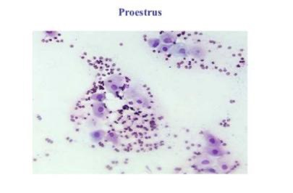

Slide 22
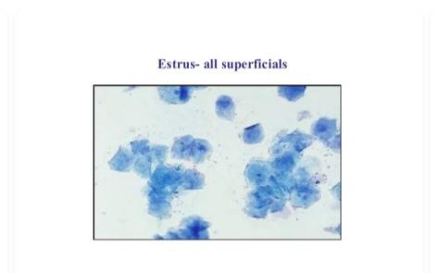

Slide 23
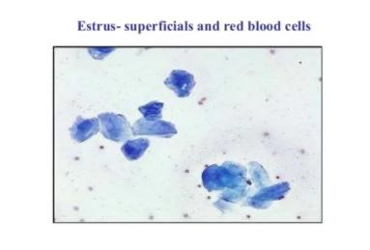

Slide 24
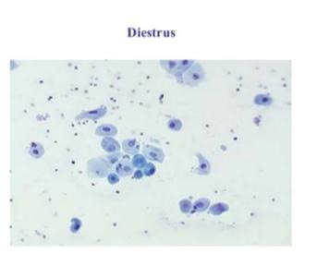

Slide 25
